Slide 1
Deep Learning

Slide 2

Representative Methods
Exponential
Smoothing
LSTM
Boosted Decision Trees
ARIMA
Seq2Seq LSTM
Support Vector Regression
Bayesian
Approach
GARCH
Random Forest
Lasso
Regression
GRU
Dilated CNN
1950s
early 1970s
late 1970s
1980s
1995
1996
1997
1999
2014
2016
Surge of DNN
methods
Statistical Methods
Classic Machine Learning
Deep Learning
J. Gooijer and R. Hyndman. 25 Years of Time Series Forecasting.

Slide 3

What is Deep Learning?
A machine learning subfield of learning representations of data. Exceptional effective at learning patterns.
Deep learning algorithms attempt to learn (multiple levels of) representation by using a hierarchy of multiple layers.
If you provide the system tons of information, it begins to understand it and respond in useful ways.

Slide 4
Why is DL is useful?
Manually designed features are often over-specified, incomplete and take a long time to design and validate
Deep learning provides a very flexible, (almost?) universal, learnable framework for representing world, visual and linguistic information.
Can learn both unsupervised and supervised
Utilize large amounts of training data
DL techniques started ~2010
First in speech and vision, then NLP

Slide 5
Neural Network Structure
Calc. the learnable parameters
4 + 2 = 6 neurons (not counting inputs)
[3 x 4] + [4 x 2] = 20 weights
(1 x 4) + (1 x 2) = 6 biases
26 learnable parameters

Slide 6
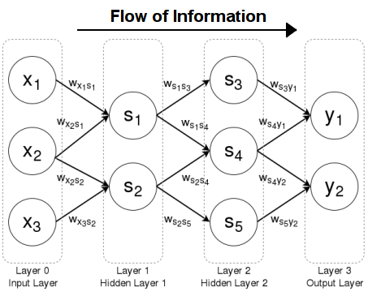
Deep Learning
One or more hidden layers and the ability to have trainable parameters in these layers
An artificial network, that is organized in hierarchical layers, has the capability to build hierarchical representations of the input data.

Slide 7
Convolutional Neural Network (CNN)
Convolutional operation
Input, e.g. an image
1 | 3 | 5 | 2 | 4
6 | 0 | 2 | 1 | 3
6 | 3 | 1 | 3 | 6
7 | 3 | 2 | 1 | 3
5 | 3 | 0 | 0 | 2
$$c_{1} =f (0.2∗1+0.7∗3 −0.5 ∗6+0.7∗0) = f(−0.7)$$
f represents some non-linear activation function
Feature map
Note: Bias terms omitted!
Filter (Kernel)
f(-0.7) | f(5.5)
0.2 | 0.7
-0.5 | 0.7

Slide 8
Convolutional Neural Network (CNN)
$$c_{1} =f (0.2∗1+0.7∗3 −0.5 ∗6+0.7∗0) = f(−0.7)$$
1 | 3 | 5 | 2 | 4
6 | 0 | 2 | 1 | 3
6 | 3 | 1 | 3 | 6
7 | 3 | 2 | 1 | 3
5 | 3 | 0 | 0 | 2
$$c_{2} =f(0.2∗3+0.7∗5 −0.5 ∗0+0.7∗2) = f(5.5)$$
Feature map
Filter (kernel)
f(-0.7) | f(5.5)
0.2 | 0.7
-0.5 | 0.7

Slide 9
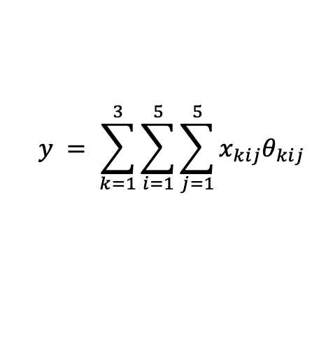
Convolutional Neural Network (CNN)
$$y = \sum_{k=1}^{3}{\sum_{i=1}^{5}{\sum_{j=1}^{5}{x_{kij}θ_{kij}}}}$$
After convolution, some other operations are performed such as applying the activation function (nonlinearity) and pooling
During training, the values that are used in the filters are updated and gradually learned

Slide 10
Convolution
Convolution layer how it works
These are the network parameters to be learned.
1 | -1 | -1
-1 | 1 | -1
-1 | -1 | 1
1 | 0 | 0 | 0 | 0 | 1
0 | 1 | 0 | 0 | 1 | 0
0 | 0 | 1 | 1 | 0 | 0
1 | 0 | 0 | 0 | 1 | 0
0 | 1 | 0 | 0 | 1 | 0
0 | 0 | 1 | 0 | 1 | 0
Filter 1
-1 | 1 | -1
-1 | 1 | -1
-1 | 1 | -1
Filter 2
……
6 x 6 image
Each filter detects a small pattern (3 x 3).

Slide 11
Convolution
Convolution
1 | -1 | -1
-1 | 1 | -1
-1 | -1 | 1
Filter 1
stride=1
1 | 0 | 0 | 0 | 0 | 1
0 | 1 | 0 | 0 | 1 | 0
0 | 0 | 1 | 1 | 0 | 0
1 | 0 | 0 | 0 | 1 | 0
0 | 1 | 0 | 0 | 1 | 0
0 | 0 | 1 | 0 | 1 | 0
Dot
product
3
-1
6 x 6 image

Slide 12
Convolution
1 | -1 | -1
-1 | 1 | -1
-1 | -1 | 1
Filter 1
If stride=2
1 | 0 | 0 | 0 | 0 | 1
0 | 1 | 0 | 0 | 1 | 0
0 | 0 | 1 | 1 | 0 | 0
1 | 0 | 0 | 0 | 1 | 0
0 | 1 | 0 | 0 | 1 | 0
0 | 0 | 1 | 0 | 1 | 0
3
-3
6 x 6 image

Slide 13
Convolution
1 | -1 | -1
-1 | 1 | -1
-1 | -1 | 1
Filter 1
stride=1
1 | 0 | 0 | 0 | 0 | 1
0 | 1 | 0 | 0 | 1 | 0
0 | 0 | 1 | 1 | 0 | 0
1 | 0 | 0 | 0 | 1 | 0
0 | 1 | 0 | 0 | 1 | 0
0 | 0 | 1 | 0 | 1 | 0
3
-1
-3
-1
-3
1
0
-3
-3
-3
0
1
3
-2
-2
-1
6 x 6 image

Slide 14
Convolution
-1 | 1 | -1
-1 | 1 | -1
-1 | 1 | -1
Filter 2
stride=1
Repeat this for each filter
1 | 0 | 0 | 0 | 0 | 1
0 | 1 | 0 | 0 | 1 | 0
0 | 0 | 1 | 1 | 0 | 0
1 | 0 | 0 | 0 | 1 | 0
0 | 1 | 0 | 0 | 1 | 0
0 | 0 | 1 | 0 | 1 | 0
3
-1
-3
-1
-1
-1
-1
-1
-3
1
0
-3
-1
-1
-2
1
Feature
Map
-3
-3
0
1
-1
-1
-2
1
3
-2
-2
-1
6 x 6 image
-1
0
-4
3
Two 4 x 4 images
Forming 2 x 4 x 4 matrix

Slide 15
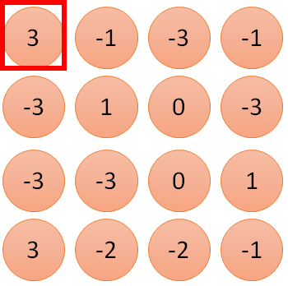
1 | -1 | -1
-1 | 1 | -1
-1 | -1 | 1
Filter 1
1
1
2
0
3
0
3
4
0
1 | 0 | 0 | 0 | 0 | 1
0 | 1 | 0 | 0 | 1 | 0
0 | 0 | 1 | 1 | 0 | 0
1 | 0 | 0 | 0 | 1 | 0
0 | 1 | 0 | 0 | 1 | 0
0 | 0 | 1 | 0 | 1 | 0
…
0
8
1
9
0
10
0
…
13
6 x 6 image
0
14
0
fewer parameters!
Only connect to 9 inputs, not fully connected
15
1
16
1
…

Slide 16
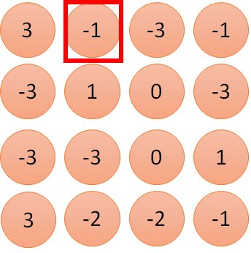
1 | -1 | -1
-1 | 1 | -1
-1 | -1 | 1
1:
1
Filter 1
2:
0
3:
0
3
4:
0
1 | 0 | 0 | 0 | 0 | 1
0 | 1 | 0 | 0 | 1 | 0
0 | 0 | 1 | 1 | 0 | 0
1 | 0 | 0 | 0 | 1 | 0
0 | 1 | 0 | 0 | 1 | 0
0 | 0 | 1 | 0 | 1 | 0
…
7:
0
8:
1
-1
9:
0
10:
0
…
13:
0
6 x 6 image
14:
0
Fewer parameters
1
15:
16:
Shared weights
Even fewer parameters
1
…

Slide 17

The whole CNN
cat dog ……
Convolution
Max Pooling
Can repeat many times
Fully Connected Feedforward network
Convolution
Max Pooling
Flattened

Slide 18
Max Pooling
1 | -1 | -1
-1 | 1 | -1
-1 | -1 | 1
-1 | 1 | -1
-1 | 1 | -1
-1 | 1 | -1
Filter 1
Filter 2
3
-1
-3
-1
-1
-1
-1
-1
-3
1
0
-3
-1
-1
-2
1
-3
-3
0
1
-1
-1
-2
1
3
-2
-2
-1
-1
0
-4
3

Slide 19
Max Pooling
Max Pooling
New image
but smaller
1 | 0 | 0 | 0 | 0 | 1
0 | 1 | 0 | 0 | 1 | 0
0 | 0 | 1 | 1 | 0 | 0
1 | 0 | 0 | 0 | 1 | 0
0 | 1 | 0 | 0 | 1 | 0
0 | 0 | 1 | 0 | 1 | 0
Conv
3
0
-1
1
Max
Pooling
3
1
0
3
2 x 2 image
6 x 6 image
Each filter
is a channel

Slide 20
The whole CNN
3
0
-1
1
Convolution
3
1
0
3
Max Pooling
Can repeat many times
A new image
Convolution
Smaller than the original image
Max Pooling

Slide 21
The whole CNN
cat dog ……
Convolution
Max Pooling
Fully Connected Feedforward network
A new image
Convolution
Max Pooling
Flattened
A new image

Slide 22
3
0
Flattening
1
3
0
-1
1
3
3
1
-1
0
3
Flattened
1
Fully Connected Feedforward network
0
3

Slide 23
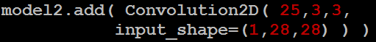
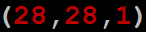
CNN in Keras
Only modified the network structure and input format (vector -> 3-D tensor)
input
Convolution
1 | -1 | -1
-1 | 1 | -1
-1 | -1 | 1
-1 | 1 | -1
-1 | 1 | -1
-1 | 1 | -1
There are 25 3x3 filters.
……
Max Pooling
Input_shape = ( 28 , 28 , 1)
28 x 28 pixels
1: black/white, 3: RGB
Convolution
3
-1
3
Max Pooling
-3
1

Slide 24
CNN in Keras
Only modified the network structure and input format (vector -> 3-D array)
Input
1 x 28 x 28
Convolution
How many parameters for each filter?
9
25 x 26 x 26
Max Pooling
25 x 13 x 13
Convolution
How many parameters
for each filter?
225=
25x9
50 x 11 x 11
Max Pooling
50 x 5 x 5

Slide 25
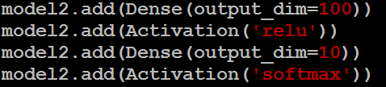
CNN in Keras
Only modified the network structure and input format (vector -> 3-D array)
Input
1 x 28 x 28
Output
Convolution
25 x 26 x 26
Fully connected feedforward network
Max Pooling
25 x 13 x 13
Convolution
50 x 11 x 11
Max Pooling
1250
50 x 5 x 5
Flattened

Slide 26
References & Resources
http://web.stanford.edu/class/cs224n
https://www.coursera.org/specializations/deep-learning
https://chrisalbon.com/#Deep-Learning
http://www.asimovinstitute.org/neural-network-zoo
http://cs231n.github.io/optimization-2
https://medium.com/@ramrajchandradevan/the-evolution-of-gradient-descend-optimization-algorithm-4106a6702d39
https://arimo.com/data-science/2016/bayesian-optimization-hyperparameter-tuning
http://www.wildml.com/2015/12/implementing-a-cnn-for-text-classification-in-tensorflow
http://www.wildml.com/2015/11/understanding-convolutional-neural-networks-for-nlp
https://medium.com/technologymadeeasy/the-best-explanation-of-convolutional-neural-networks-on-the-internet-fbb8b1ad5df8
http://www.wildml.com/2015/09/recurrent-neural-networks-tutorial-part-1-introduction-to-rnns/
http://www.wildml.com/2015/10/recurrent-neural-network-tutorial-part-4-implementing-a-grulstm-rnn-with-python-and-theano/
http://colah.github.io/posts/2015-08-Understanding-LSTMs
https://github.com/hyperopt/hyperopt
https://github.com/tensorflow/nmt

